Slide 1
Unit No: 2
COMBINATIONAL CIRCUITS
Notes:
Unit I:Introduction to Software Engineering, Software Process Models

Slide 2
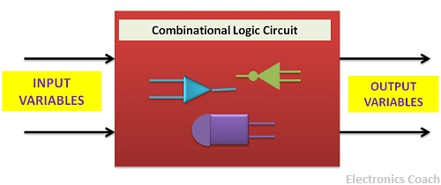
COMBINATIONAL CIRCUITS
The combinational logic circuit comprises of logic gates and thus the output obtained is directly related to the input.
The word combinational is derived from the word combination which means two or more elements combined together by means of single operation.

Slide 3
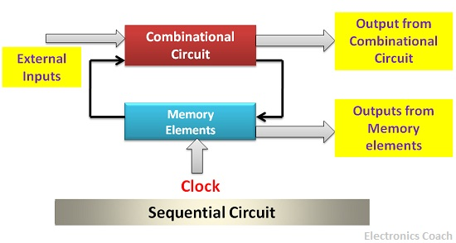
Sequential Logic Circuit
The sequential logic circuit also involves memory elements along with the logic gates. Thus, the output generated by the sequential circuit depends not only on the present state of the input but also on the previous outputs.

Slide 4
INTRODUCTION
Two classes of logic circuits
  Combinational
  Sequential
Combinational Circuit
  Each output depends entirely on the immediate (present) inputs.
Sequential Circuit
  Each output depends on both present inputs and state.
Combinational
Logic
Combinational
Logic
inputs
: :
: :
outputs
inputs
: :
: :
outputs
Memory

Slide 5
COMBINATIONAL CIRCUITS
Introduction
Design Methods
Half Adder
Full Adder
Code converter
Look-Ahead Carry Adder

Slide 6
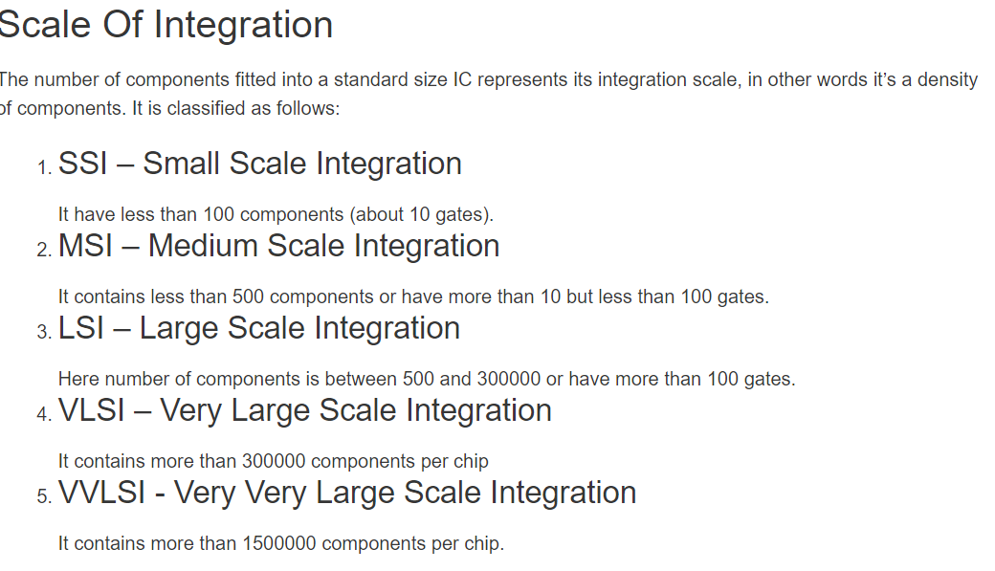
DESIGN METHODS
Design methods make use of logic gates and useful function blocks
  These are available as Integrated Circuit (IC) chips.
  Types of IC chips (based on packing density): SSI, MSI, LSI, VLSI, ULSI.

Slide 7
Main objectives of circuit design:
Reduce cost
Increase speed
Design simplicity

Slide 8
DESIGN: HALF ADDER
Design procedure:
  1. State problem
  Example: Build a Half Adder.
  2. Determine and label the inputs and outputs of circuit.
  Example: Two inputs and two outputs labelled, as shown below.
X | Y | C | S
0 | 0 | 0 | 0
0 | 1 | 0 | 1
1 | 0 | 0 | 1
1 | 1 | 1 | 0
X
Y
Half
Adder
S
C
(X + Y)
  3. Draw the truth table.

Slide 9
DESIGN: HALF ADDER
X 0
1
Y 0 1
 | 1
  4. Obtain simplified Boolean functions.
  Example: C = X⋅Y
  S = X'⋅Y + X⋅Y' = X⊕Y
1
X 0
1
Y 0 1
1
1
  5. Draw logic diagram.
1
X
Y
S
Half Adder
C

Slide 10
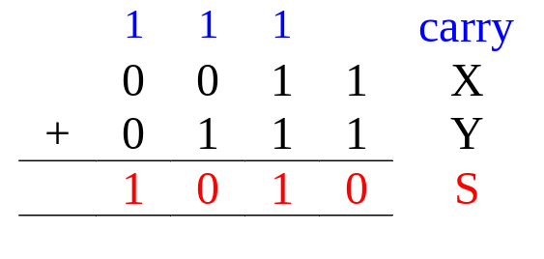
DESIGN: FULL ADDER
Half adder adds up only two bits.
To add two binary numbers, we need to add 3 bits (including the carry).
  Example:
Need Full Adder (it can be made from two half adders).
X
Y
Z
Full
Adder
S
C
(X + Y + Z)

Slide 11
DESIGN: FULL ADDER
Truth table:
X | Y | Z | C | S
0 | 0 | 0 | 0 | 0
0 | 0 | 1 | 0 | 1
0 | 1 | 0 | 0 | 1
0 | 1 | 1 | 1 | 0
1 | 0 | 0 | 0 | 1
1 | 0 | 1 | 1 | 0
1 | 1 | 0 | 1 | 0
1 | 1 | 1 | 1 | 1
Note:
Z - carry in (to the current position)
C - carry out (to the next position)
C
YZ
00 01 11 10
X
0
1
1
1
1
1
Using K-map, simplified SOP form:
  C = ?
  S = ?
S
YZ
00 01 11 10
X
0
1
1
1
1
1


Slide 12
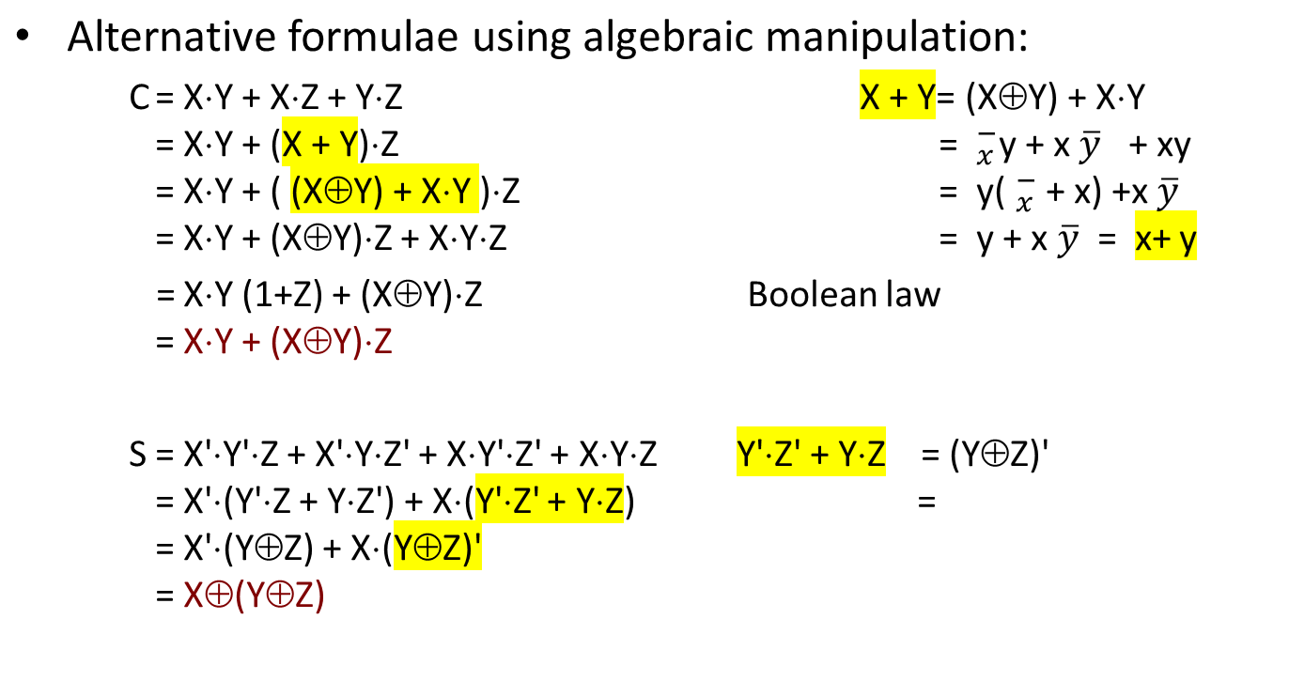
DESIGN: FULL ADDER

Slide 13
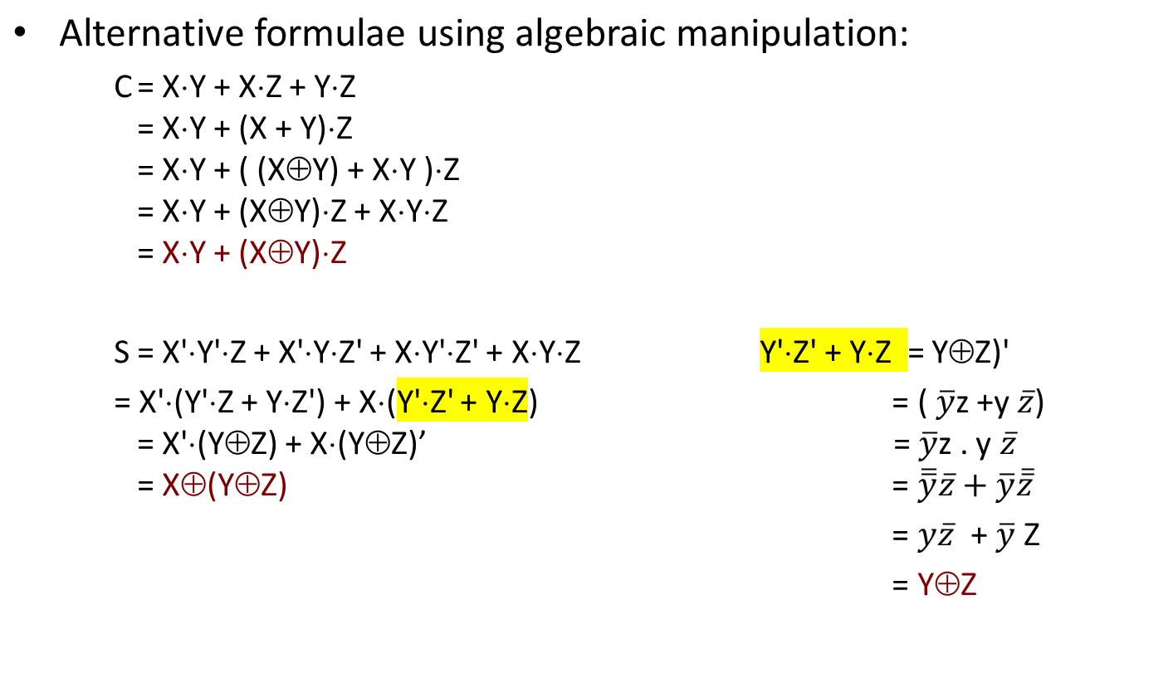
DESIGN: FULL ADDER

Slide 14
DESIGN: FULL ADDER
Circuit for above formulae:
  C = X⋅Y + (X⊕Y)⋅Z
  S = X⊕(Y⊕Z)
X
Y
(X⊕Y)
S
(X⋅Y)
C
Z
Full Adder made from two Half-Adders (+ an OR gate).

Slide 15
DESIGN: FULL ADDER
Circuit for above formulae:
  C = X⋅Y + (X⊕Y)⋅Z
  S = X⊕(Y⊕Z)
Block diagrams.
X
Y
X
Y
(X⊕Y)
Sum
X
Y
Sum
S
Half
Adder
Half
Adder
Carry
(X⋅Y)
Carry
C
Z
Full Adder made from two Half-Adders (+ an OR gate).

